Slide 1

E-wallet Web Application
Graphical User Interfaces Project
Davide Scaccia, Danilo Spera, Arcangelo Mauro, Giovanni Romano, Arthur Phommachanh

Slide 2

Introduction:
Our project is CashHive, an e-wallet application with the following features:
Login - Register
Deposit
Withdraw
Budget
Transaction History
Send/Receive Money
Request Money
Piggy Bank
Friend List

Slide 3



Overview Of Technologies:
Frontend:
PrimeFaces
Backend:
Jakarta EE
PostgreSQL

Slide 4
Team Members’ Work:
Implementation Details:
Code Contributions:
Davide Scaccia: Entities/, AuthService, EmailService, RateLimiterService, RegistrationResult SecurityFilter, SessionTimeoutConfig, UserBean, VerificationBean, DatabaseMigration, DatabasePrint.
Arcangelo Mauro: WithdrawalBean, SendBean
Danilo Spera: RequestBean, DepositBean, BankApiSimulator, RestApplication, SimulatedPayment, PaymentInfo, PaymentService, bank-simulator Application.
Giovanni Romano: TransactionBean, BudgetBean
Arthur Phommachanh: PiggyBank, FriendList, store-simulator Application
Tasks handled together: pom.xml, web.xml, persistence.xml, Database Schema

Slide 5
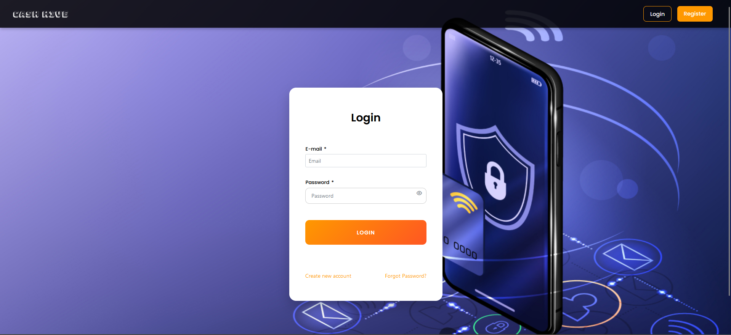
Screenshots of Application: Login

Slide 6
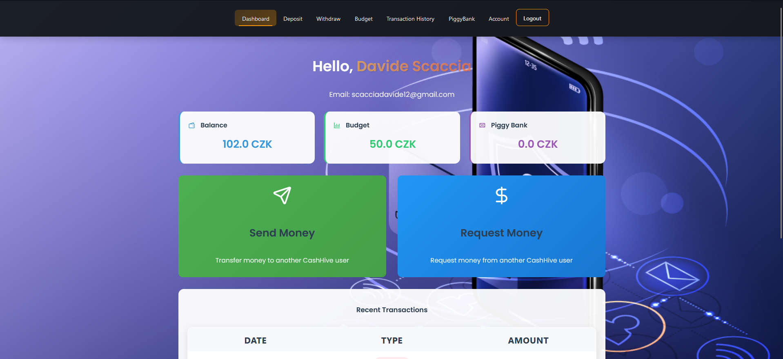
Screenshots of Application: Dashboard

Slide 7
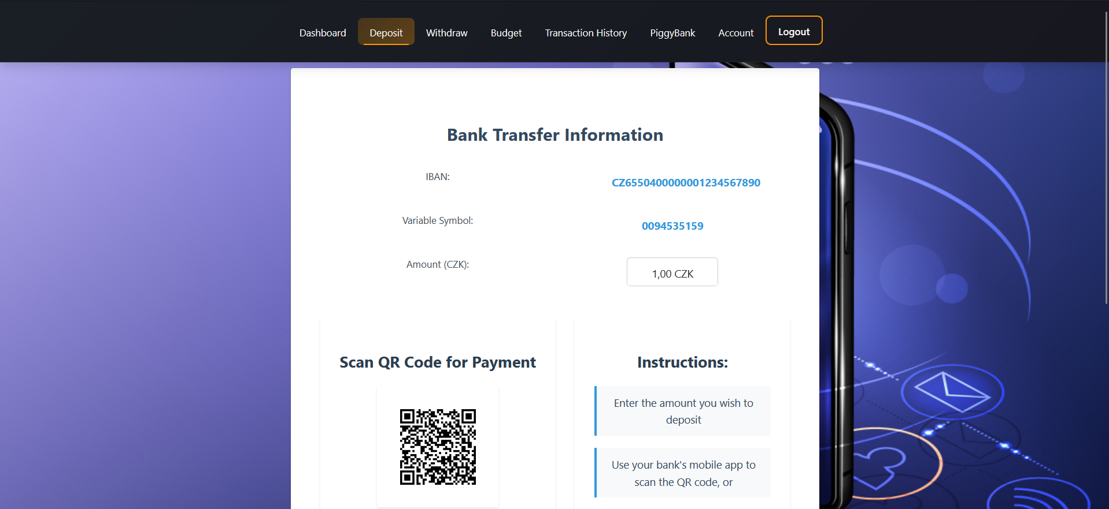
Screenshots of Application: Deposit

Slide 8
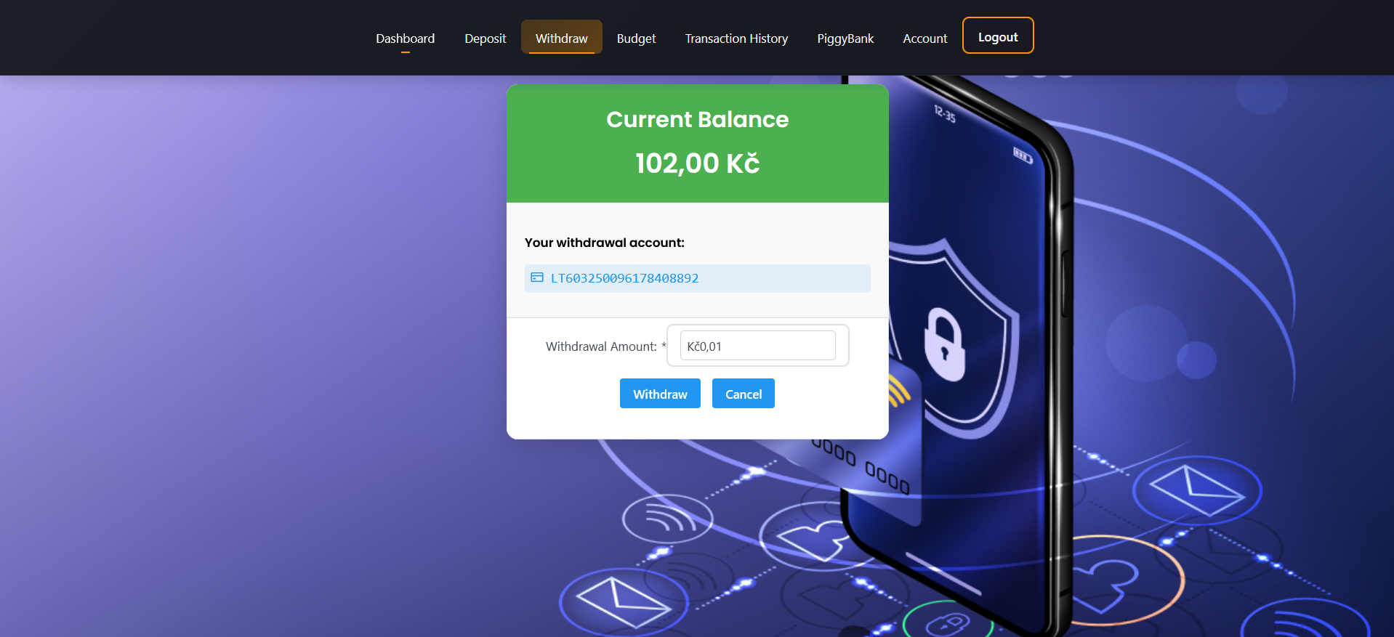
Screenshots of Application: Withdraw

Slide 9
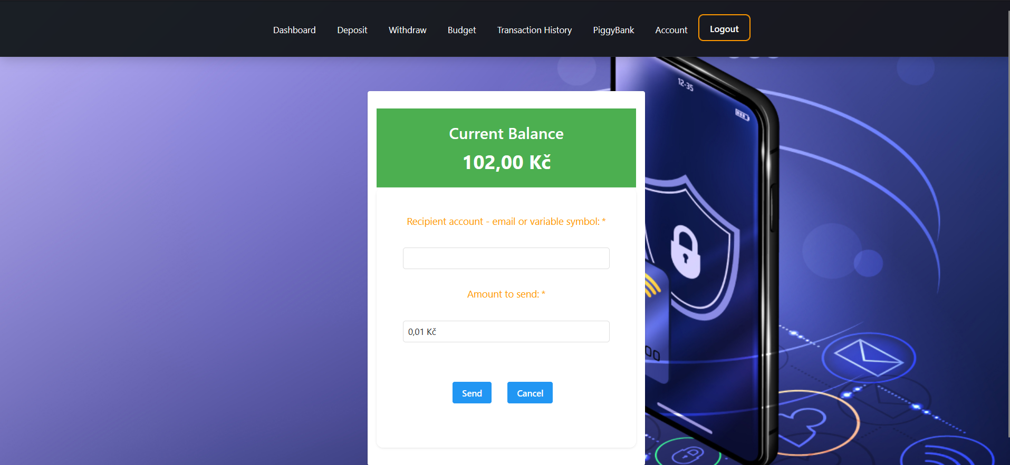
Screenshots of Application: Send

Slide 10
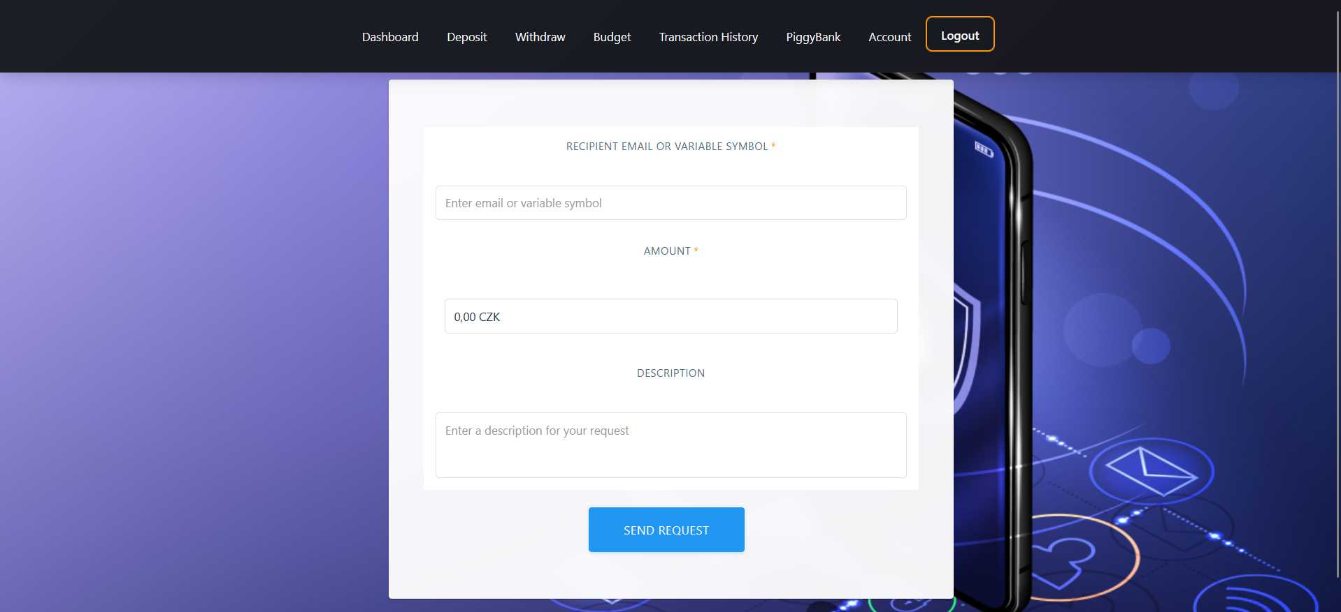
Screenshots of Application: Request

Slide 11
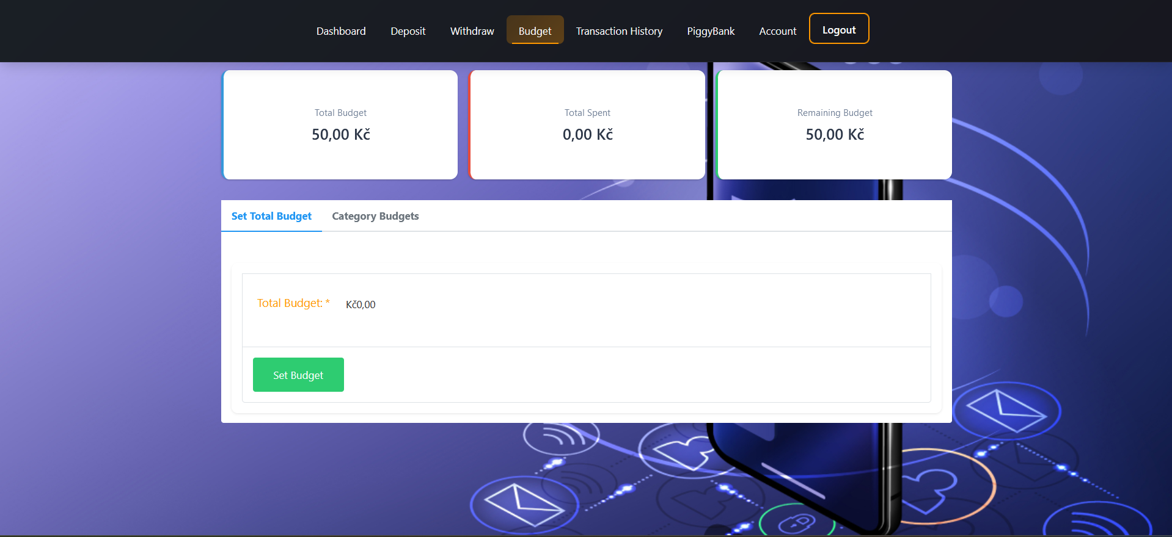
Screenshots of Application: Budget

Slide 12
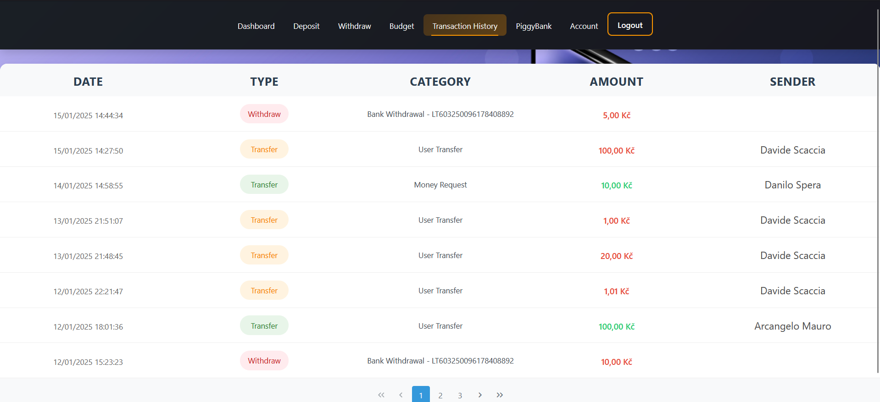
Screenshots of Application: Transactions

Slide 13
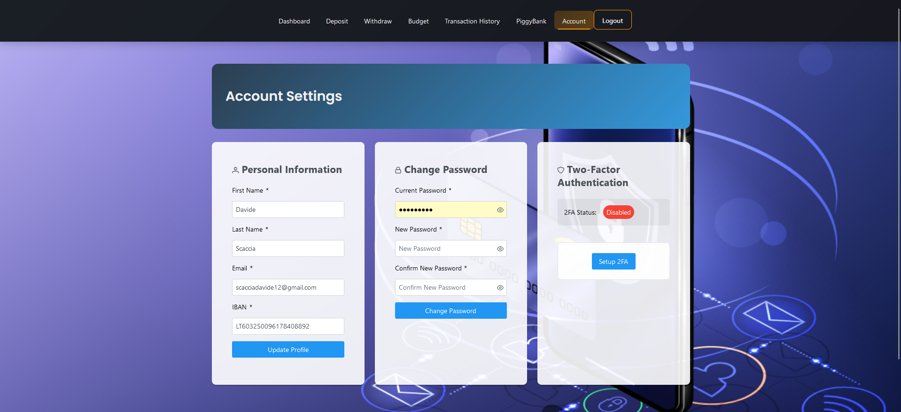
Screenshots of Application: Account

Slide 14
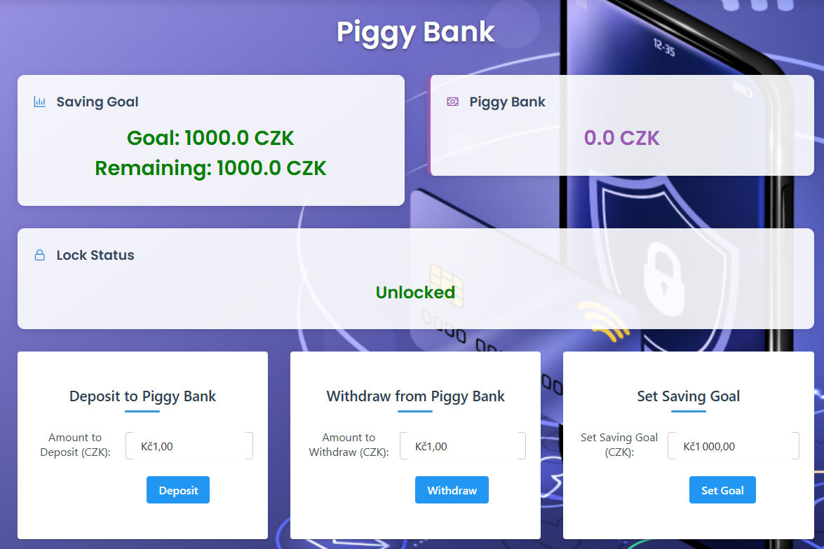
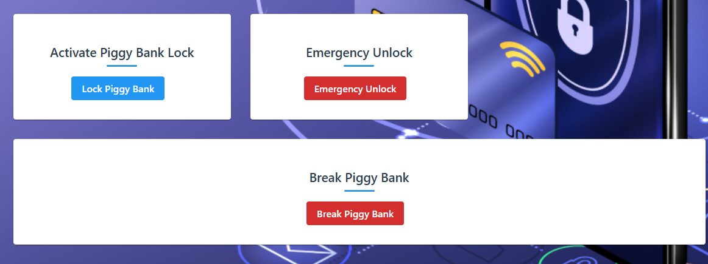
Screenshots of Application: PiggyBank

Slide 15
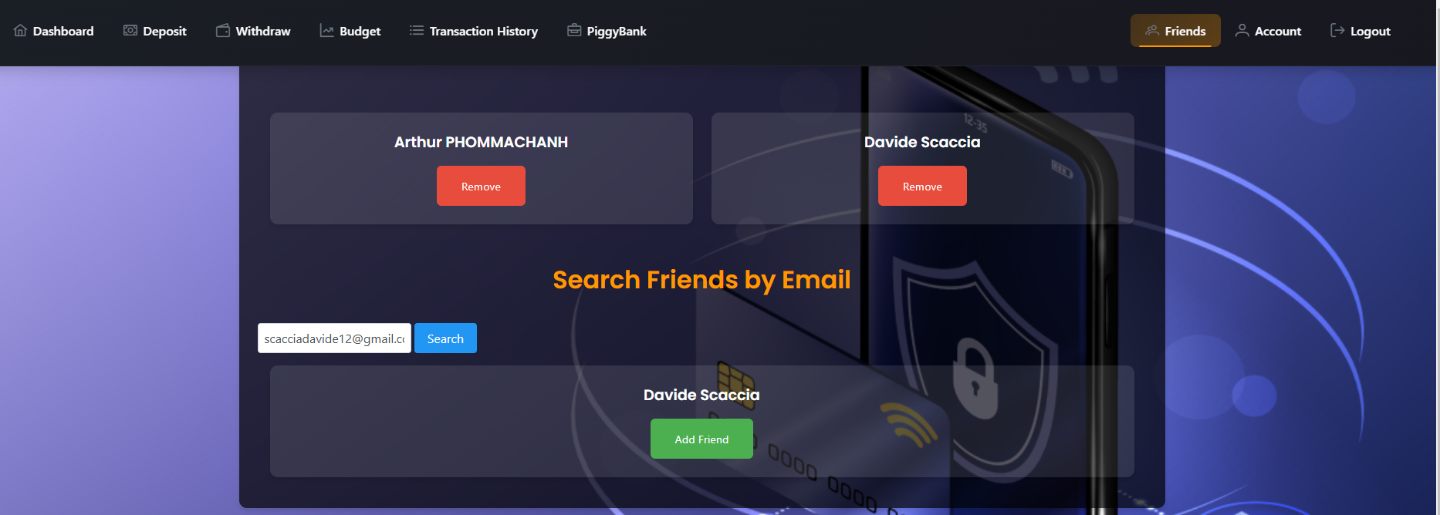
Screenshots of Application: FriendList

Slide 16
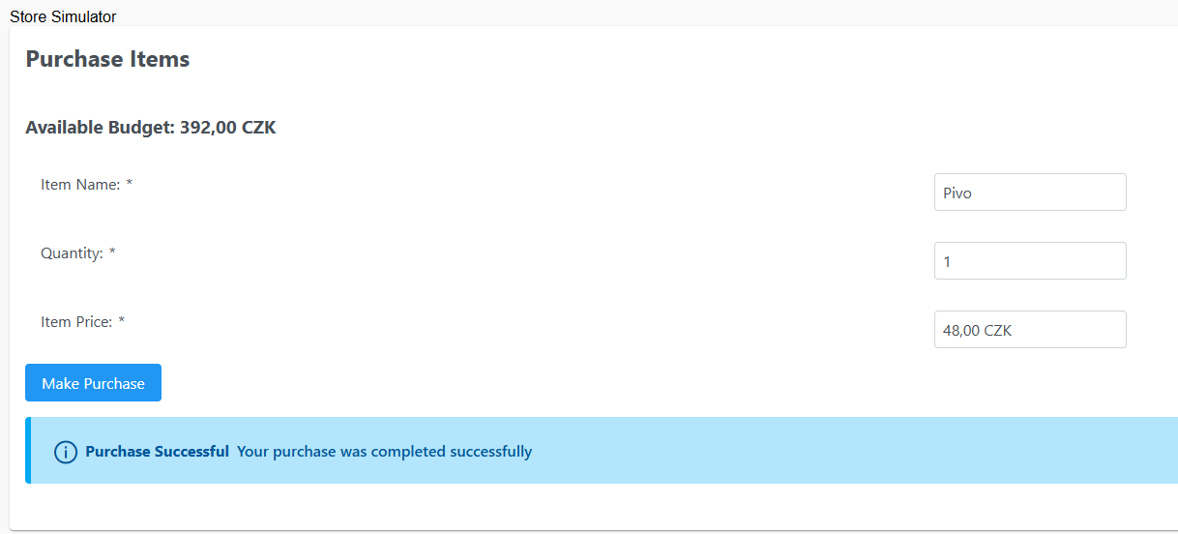
Screenshots of Application: Store Simulator

